Slide 1
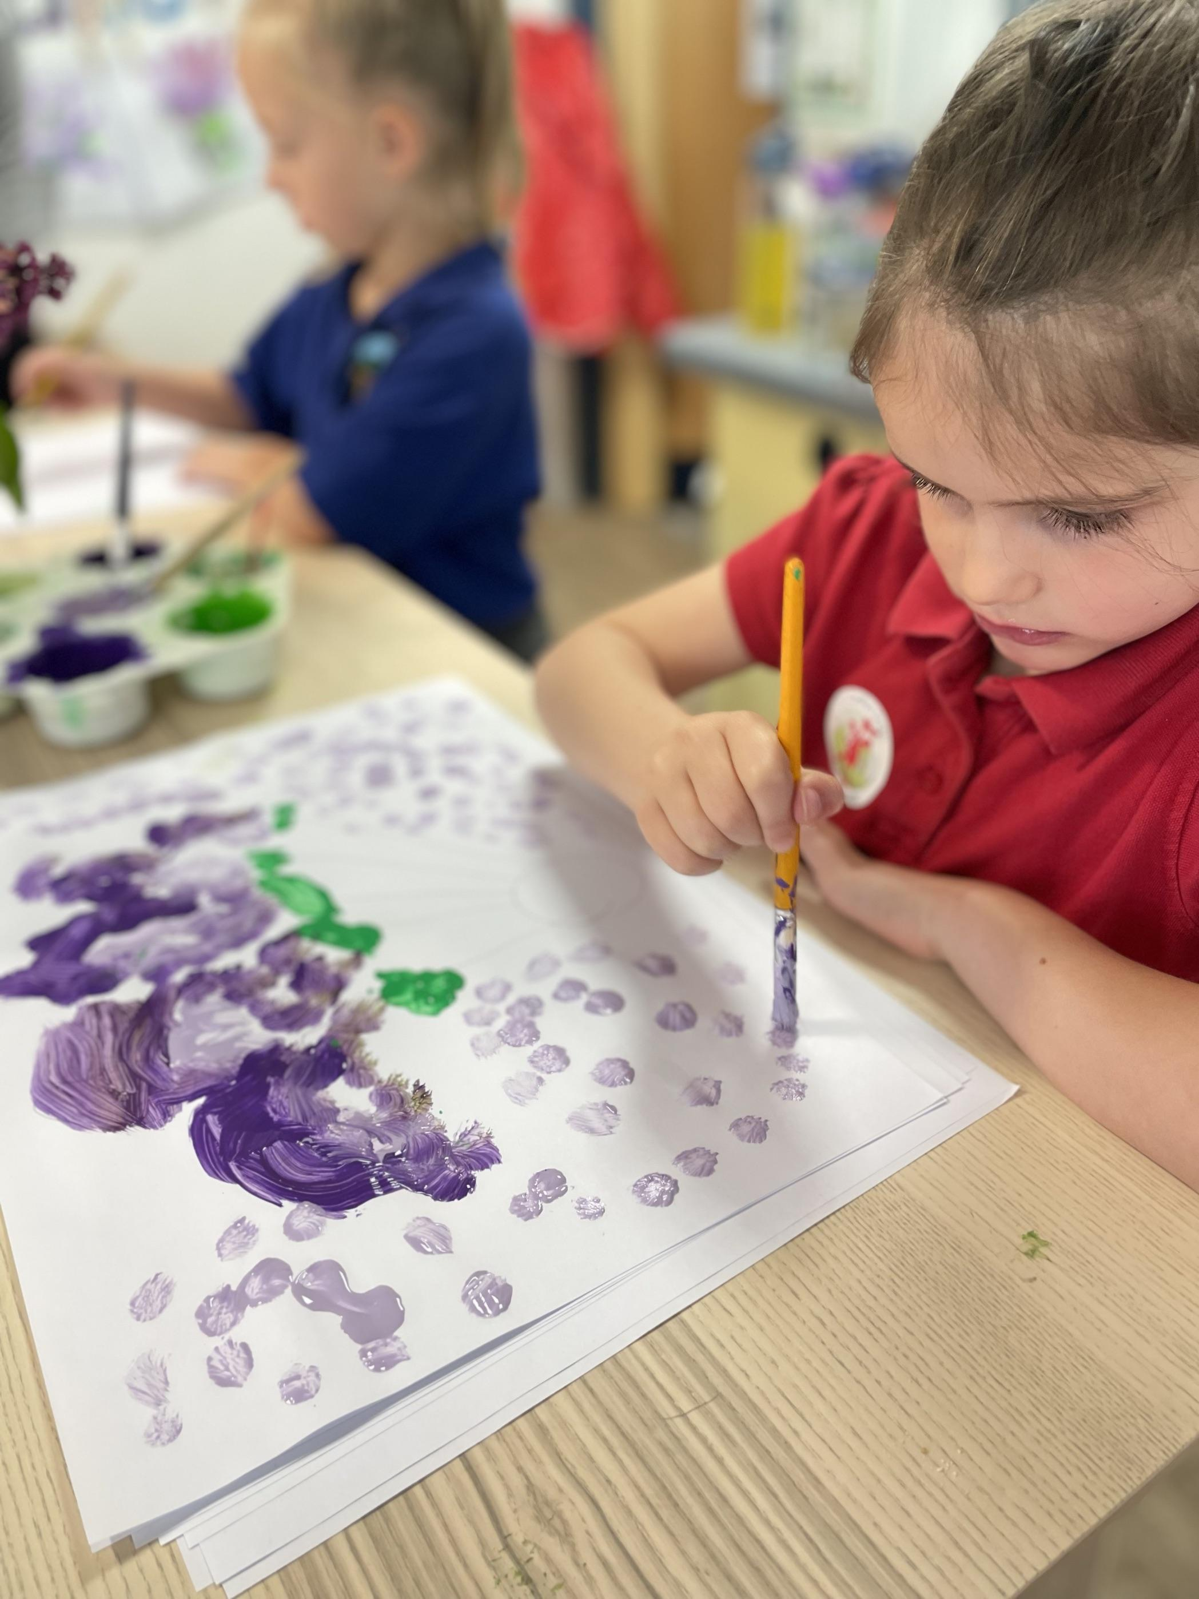
Annual Report to Parents
Sofrydd Primary School
2026-2027

Slide 2
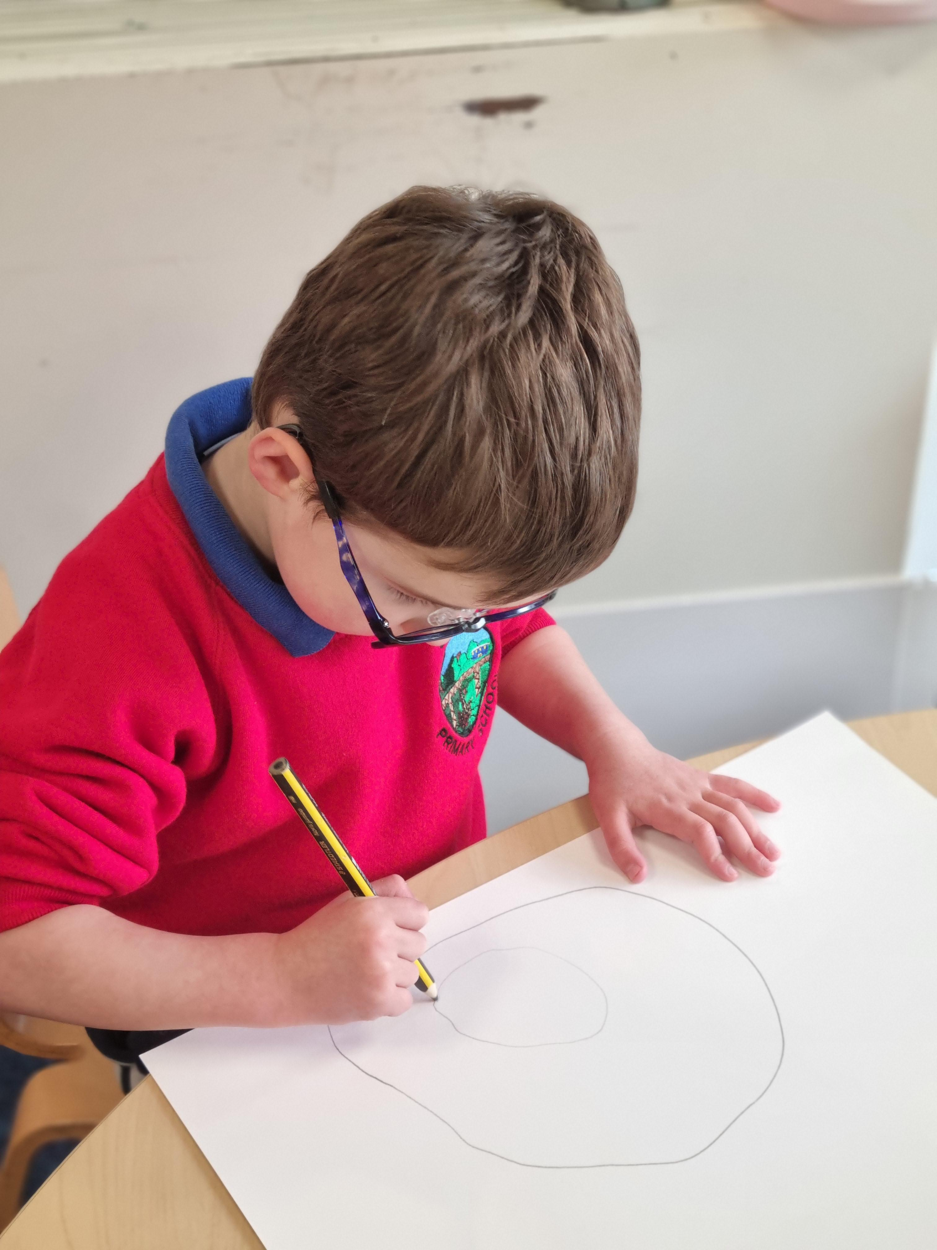
Table of Contents
Introduction
Term dates
Governing Body Members Details
Curriculum design and Curriculum Exhibition
Progression and Assessment
Financial Summary
Community links
Extra Curricular Activities
Summary of School Development Plan

Slide 3
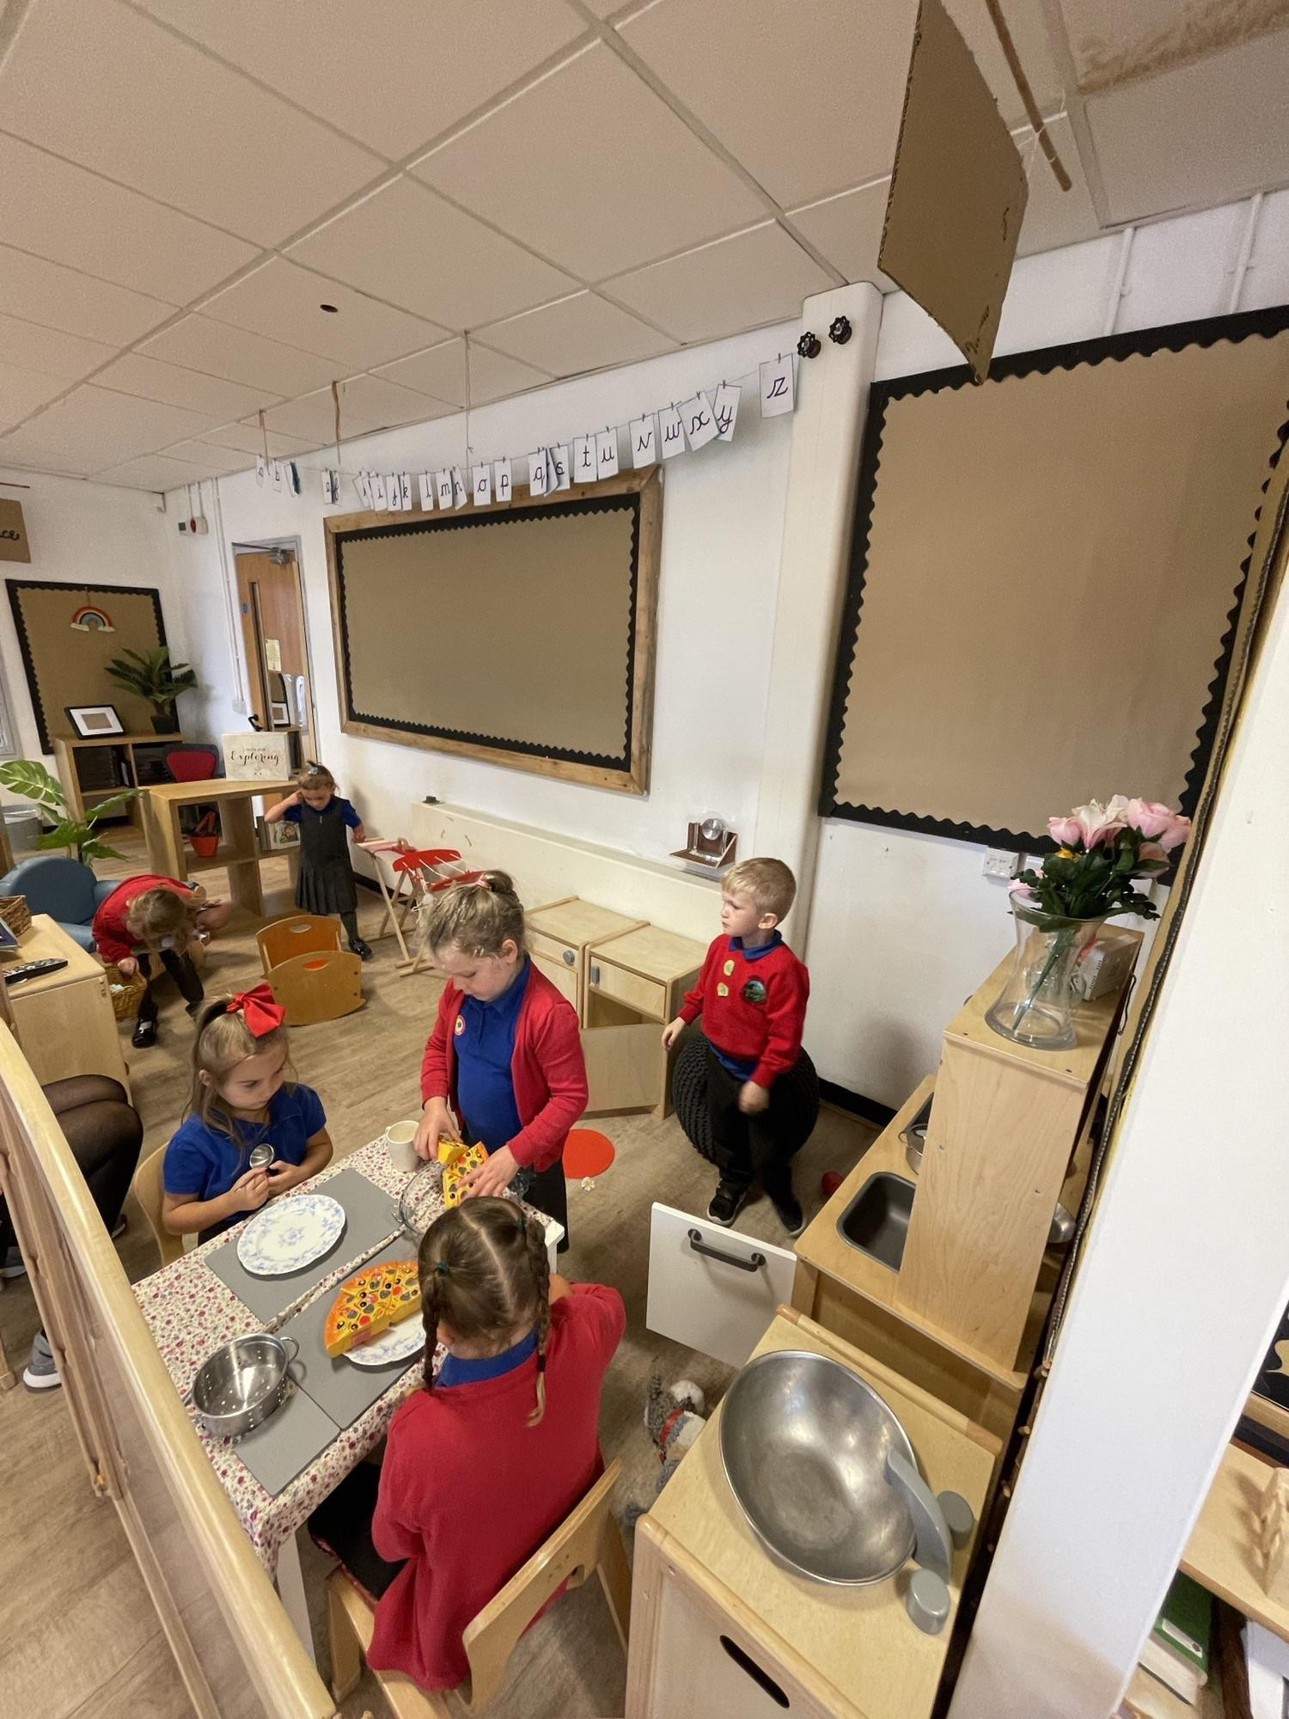
Introduction
Welcome to the Annual Report to Parents for the academic year 2026-2027. The aim of the report is to provide information for parents and provide information about our school.
At Sofrydd Primary School, we cater for approximately 150 pupils. We have a modern site with excellent facilities that include bright classrooms, a library, a Digi Den for using our technology skills. We are also fortunate to have a nurture class to support all our groups of learners. Additionally we have a spacious hall, which includes our pupil led café.
Our grounds are spacious with a Multi Use Sports Area, an adventure playground and a sports field. Every child has access to appropriate toilet facilities and our cleaning provision ensures that all children have access to a bright and welcoming learning environment.
We are proud of our Welsh heritage and we promote daily Welsh language lessons. We aim to ensure our daily Welsh is incorporated in every day activities and are pleased to have achieved our Campus Cymraeg Bronze award.
A meeting for all parents to discuss our school journey is held in September and this is an opportunity for parents and carers to visit our school and discuss the report content.

Slide 4
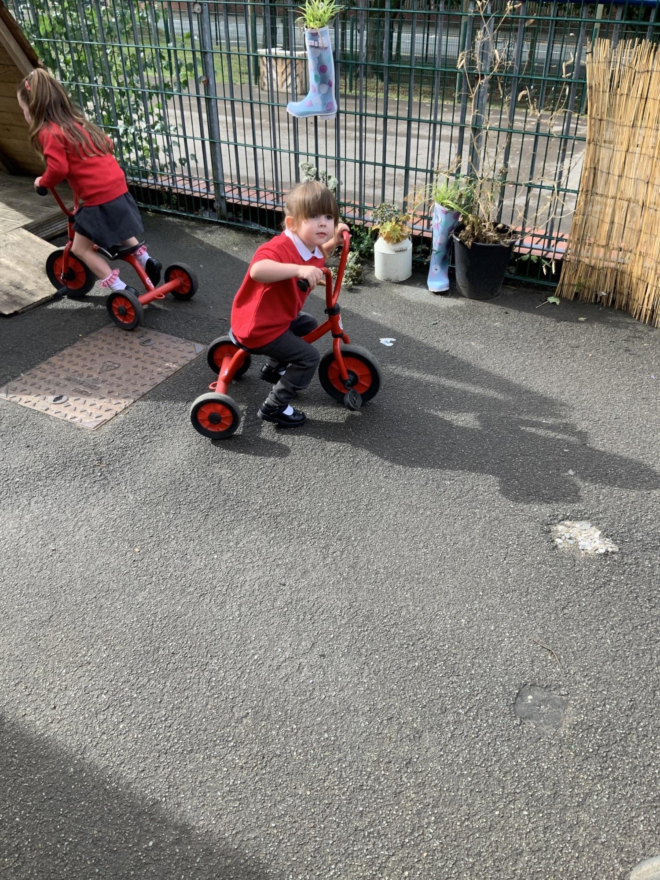
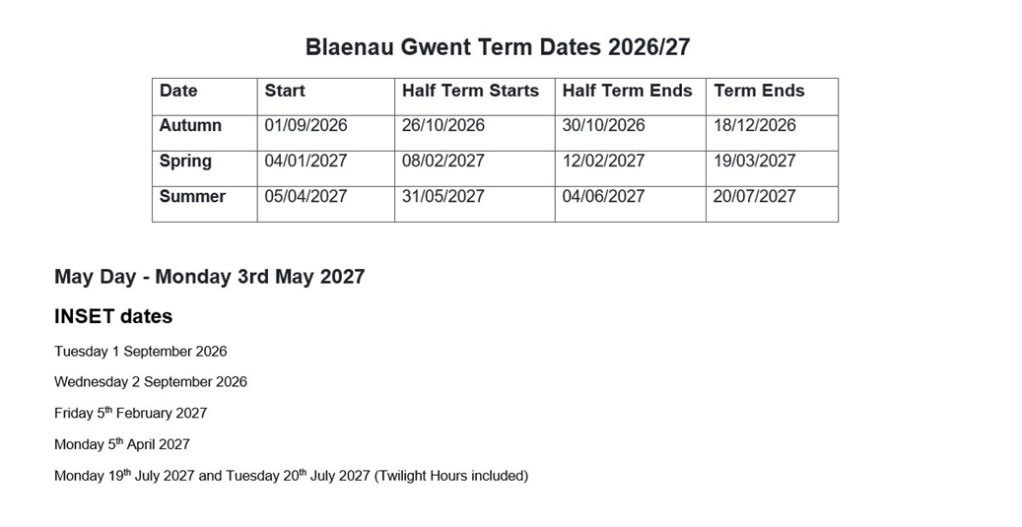
Term Dates 2026-2026

Slide 5
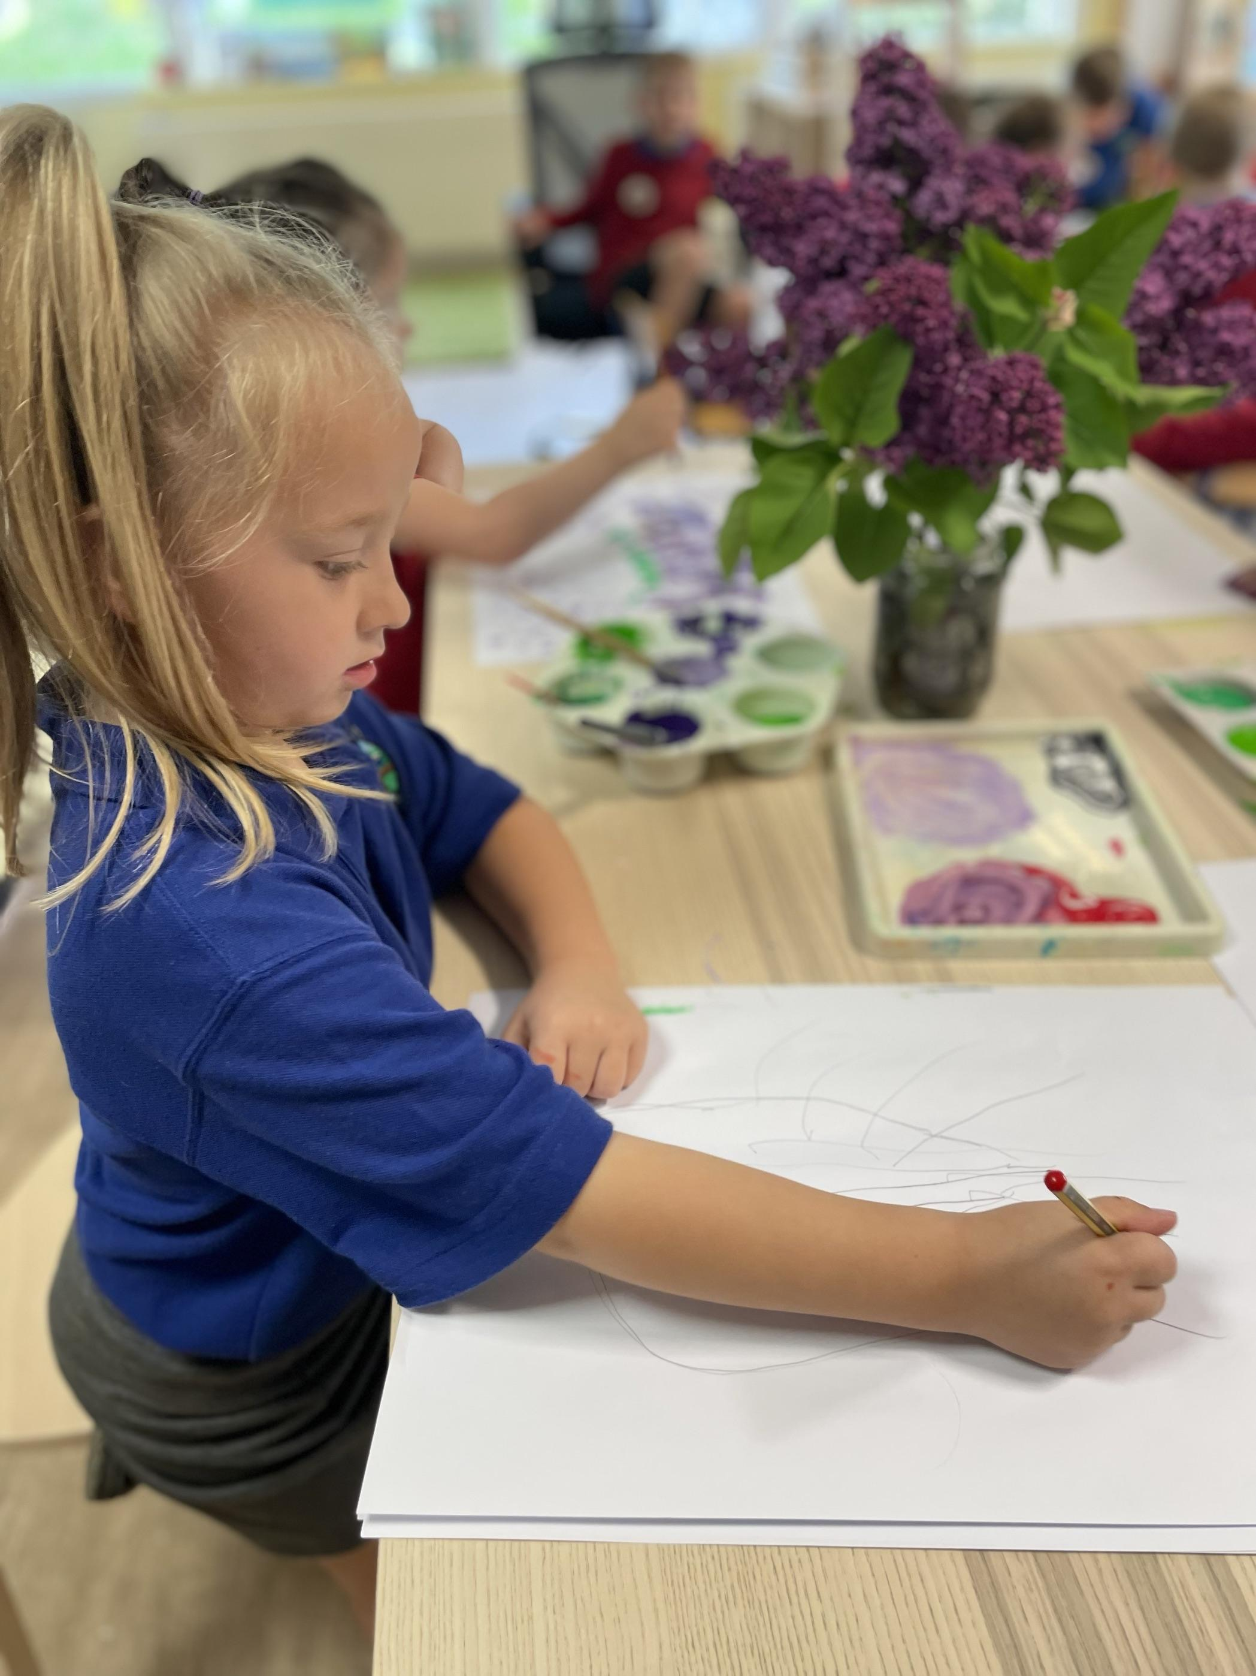
Members’ Details
The Governing Body, Headteacher and Deputy Headteacher share responsibility for the strategic management of the school, acting within the framework set by National legislation and have separate and particular responsibilities for the selection and management of staff.
The internal management of the school is the responsibility of the Headteacher.
The full Governing Body meets at least once a term and additional sub-committee meetings are held half termly to discuss specific issues.
The minutes of Governing Body meetings are available from the clerk to governors.
Chair Mrs Debbie Field
Vice Chair Mr Phil Dando
Community Governors Mr Ben Owen-Jones
Mrs Paula Flook
LA appointed Mrs Helen Cunningham
Mr Phil Dando
Staff Governor Mrs Esther Allan
Mr Dean Stevens
Parent Governor Mrs Gemma Palmer
Mr Gareth Green
Mrs Angela Davies
Mrs Angharad Thomas

Slide 6
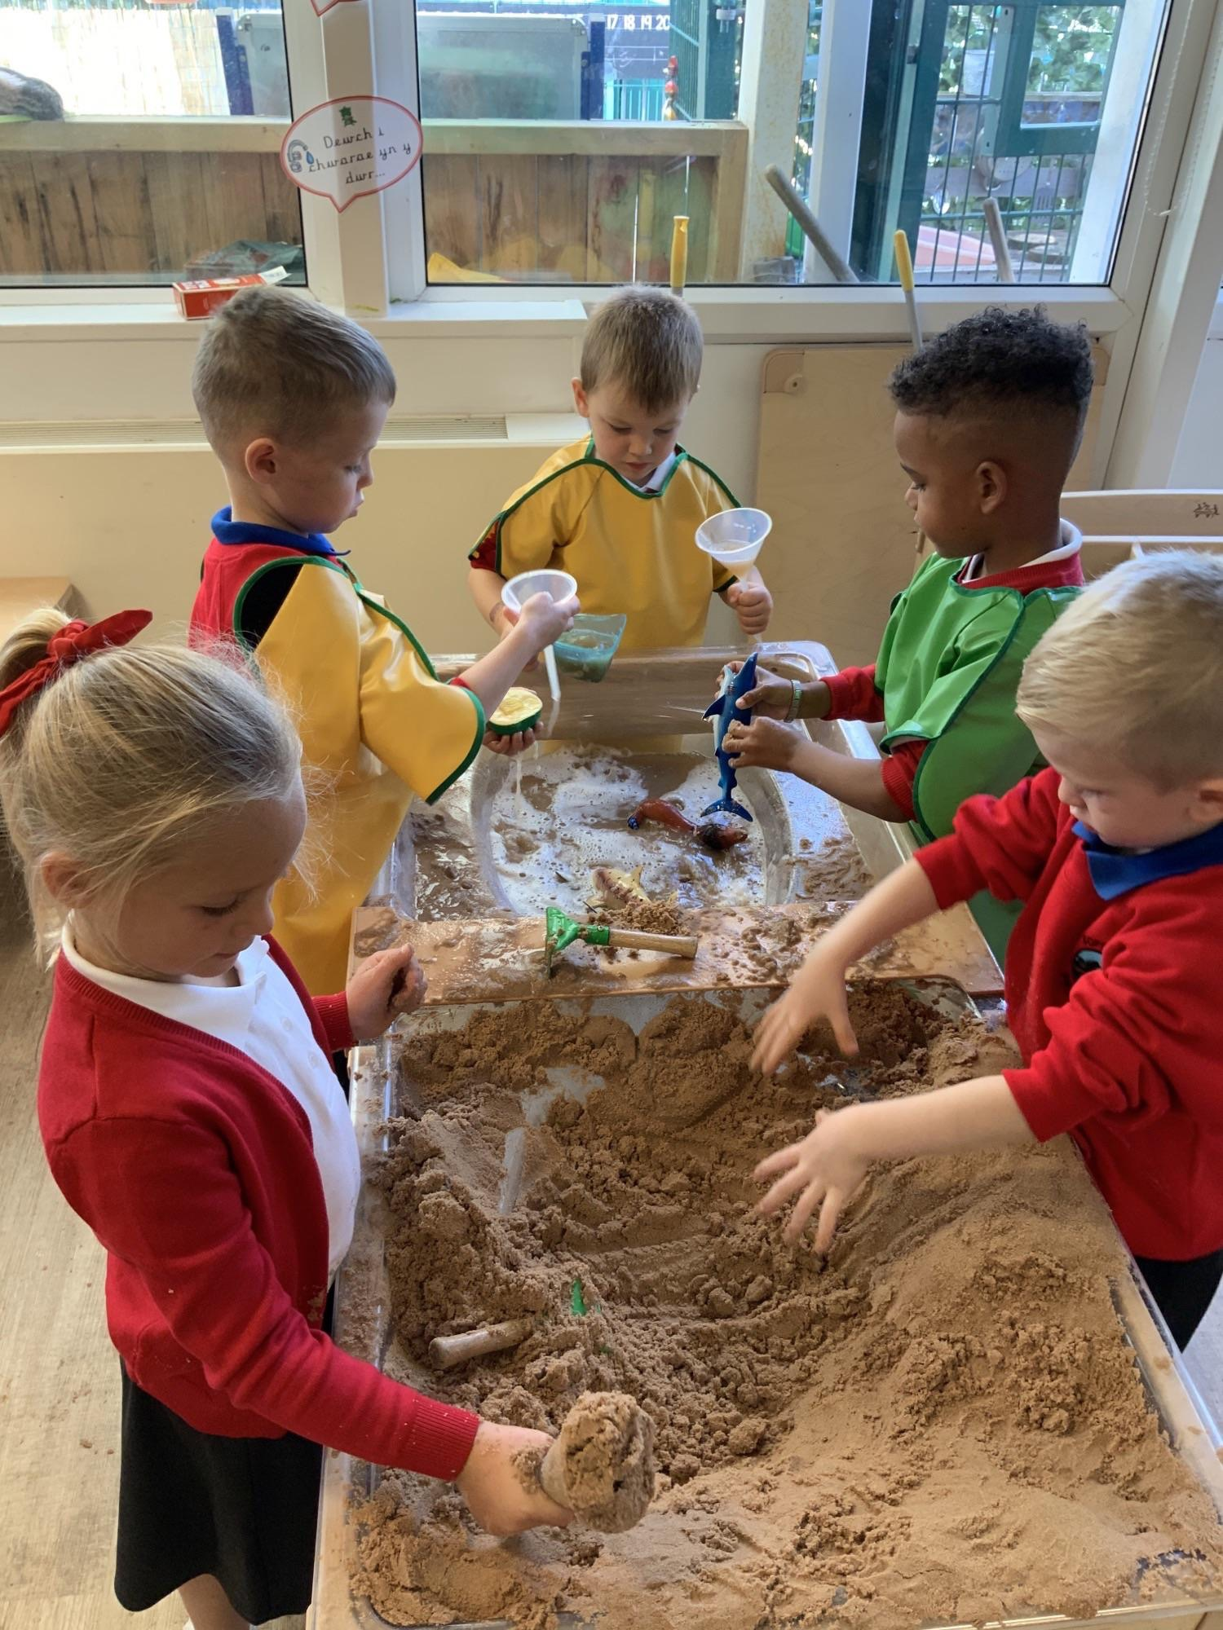
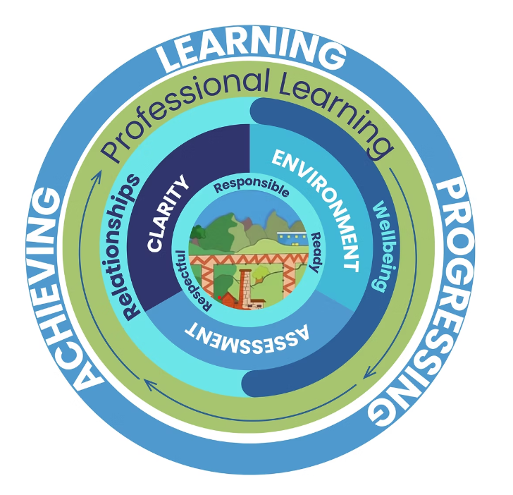


Our Curriculum
Our Pupil Voice groups feature prominently at Sofrydd Primary
The Six Areas of Learning are Literacy, Maths, Science & Technology, Humanities, Health & Wellbeing and Expressive Arts. In our thematic approach we have a curriculum driver each term to ensure all skills are taught

Slide 7
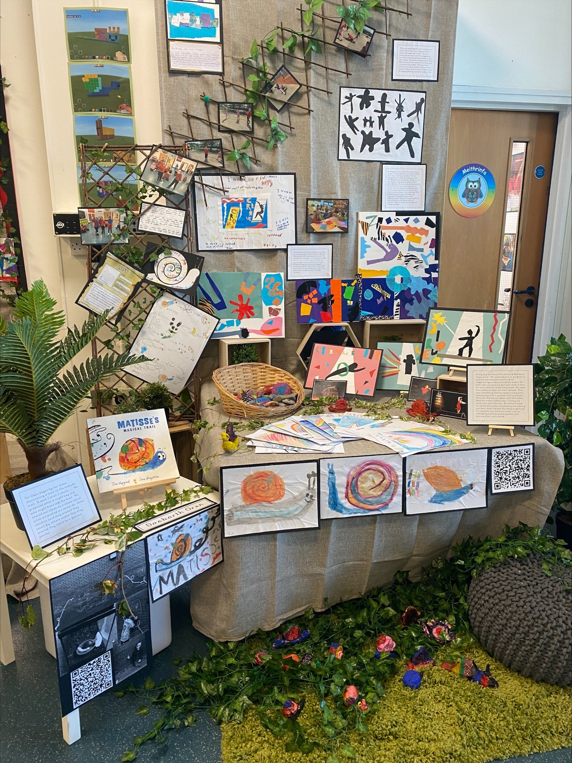


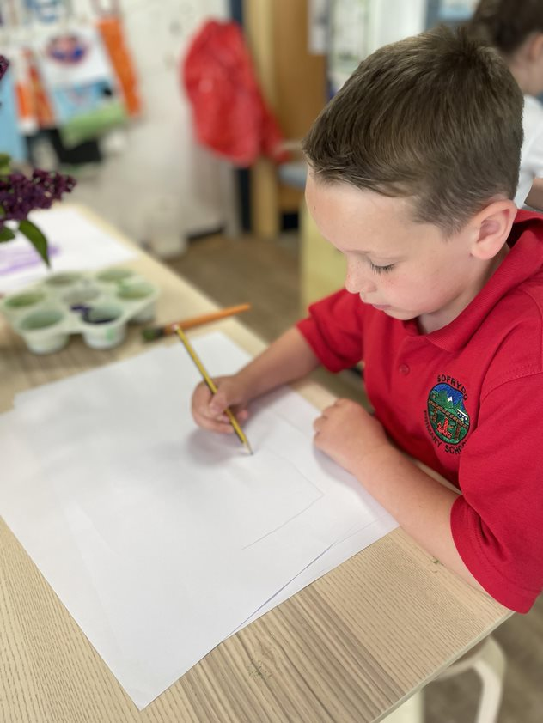
A fabulous exhibition which is really well planned. It is nice to be invited to the school to see
Curriculum in Action
Feedback from families
Beautiful work by the children. Lots of bright colours. We enjoyed hearing all about their work
Lovely to see the progression of skills from Nursey to Year 6. Beautiful, natural displays. The children enjoyed discussing their work

Slide 8
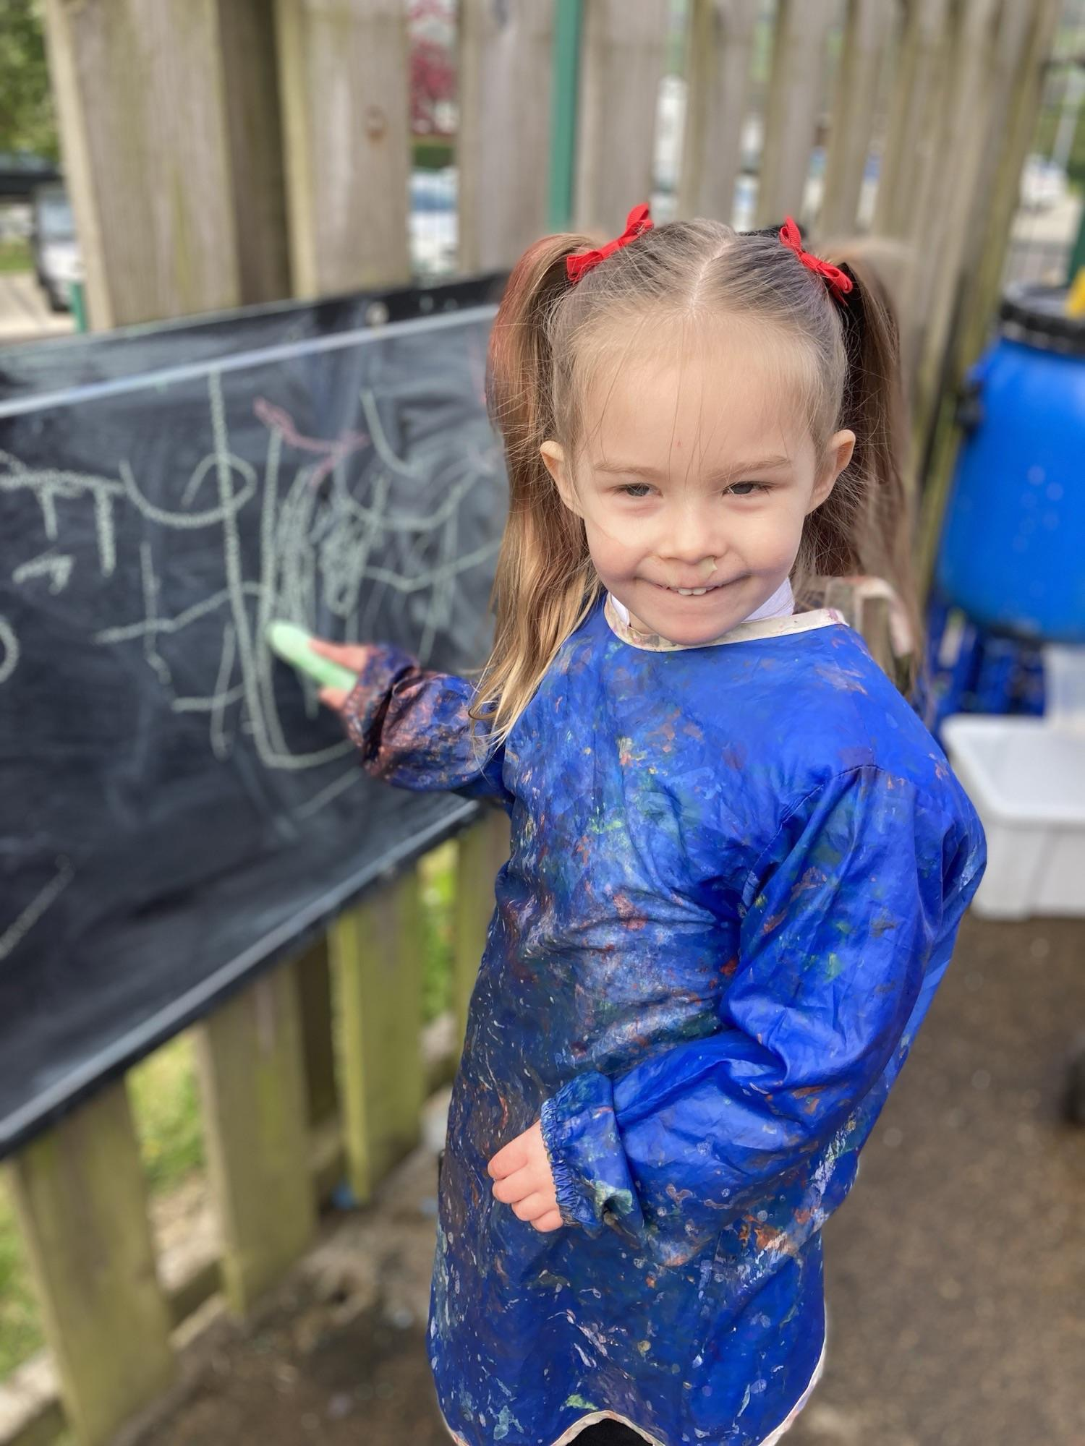
Progression and Assessment
Assessments are undertaken across the school every term. These assessments include Reading, Spelling, Phonics, Writing, Oracy and assessment of pupils attitudes to self and school
We have a suite of assessment tools to help us assess and review learner’s progress
At the start of every term we complete a ‘Class on a Page’ review called Assessing Learner Progress. This is reviewed termly and progress markers made
We use a range of assessments to review progress ‘in the moment’
Intervention Plans are short programmes for identified children in key areas of the curriculum. Progress is reviewed termly during Pupil Progress Meetings
Every term we hold a Pupil Progress meeting to discuss pupil progress and identify those learners who may require an Intervention Support Plan

Slide 9
Financial Summary
Employees £1,145,256
Other Employees £80,487
Premises £59,399
Supplies & Services £103,242
Income £14,563
Net Expenditure £1,431,768
Grants £143,189

Slide 10
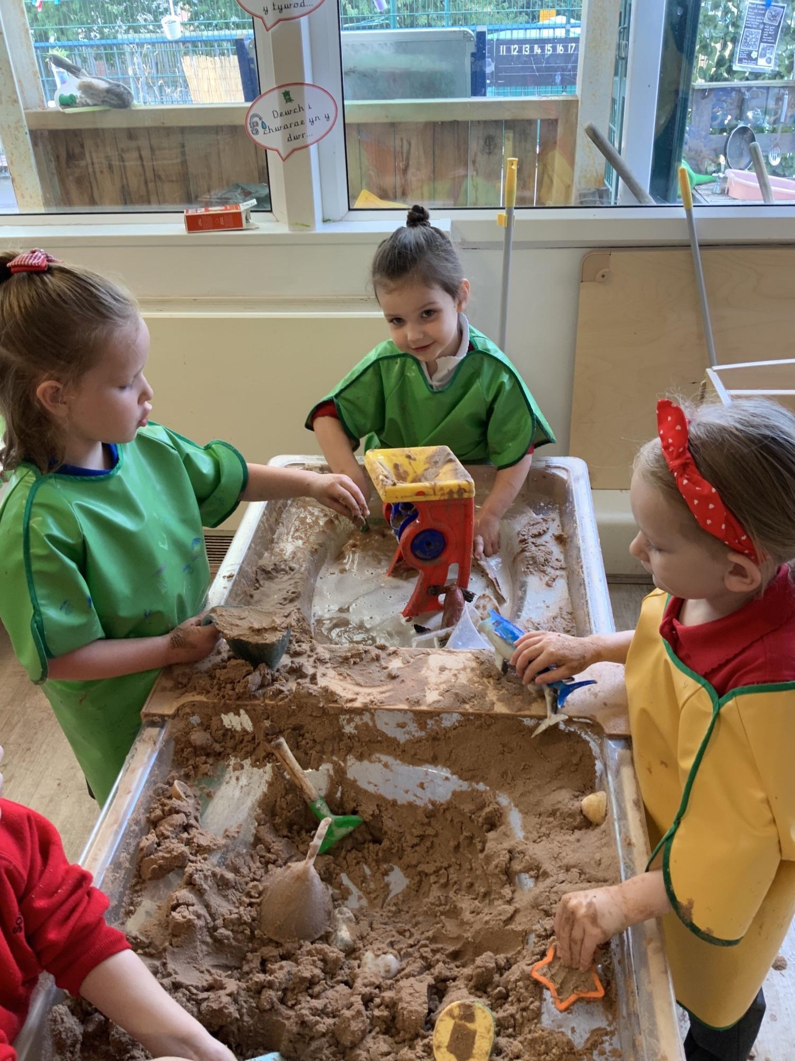
Community Links
Community links have been strengthened with several Parent and Child curriculum celebration events undertaken throughout the year
Parent, Teacher and Friends Association meets regularly with fortnightly meetings to support our school improvement journey
Parent skills sessions have been successful with our parents coming into school to talk to children all about their own career experiences
A community Fun Run has been established with all community groups coming together including Swyfrdd Community Centre, our Local Councillors and the Community Group “Off the Streets”
The school building and outdoor facilities are used by local community groups every week. Bringing the community and young people together

Slide 11
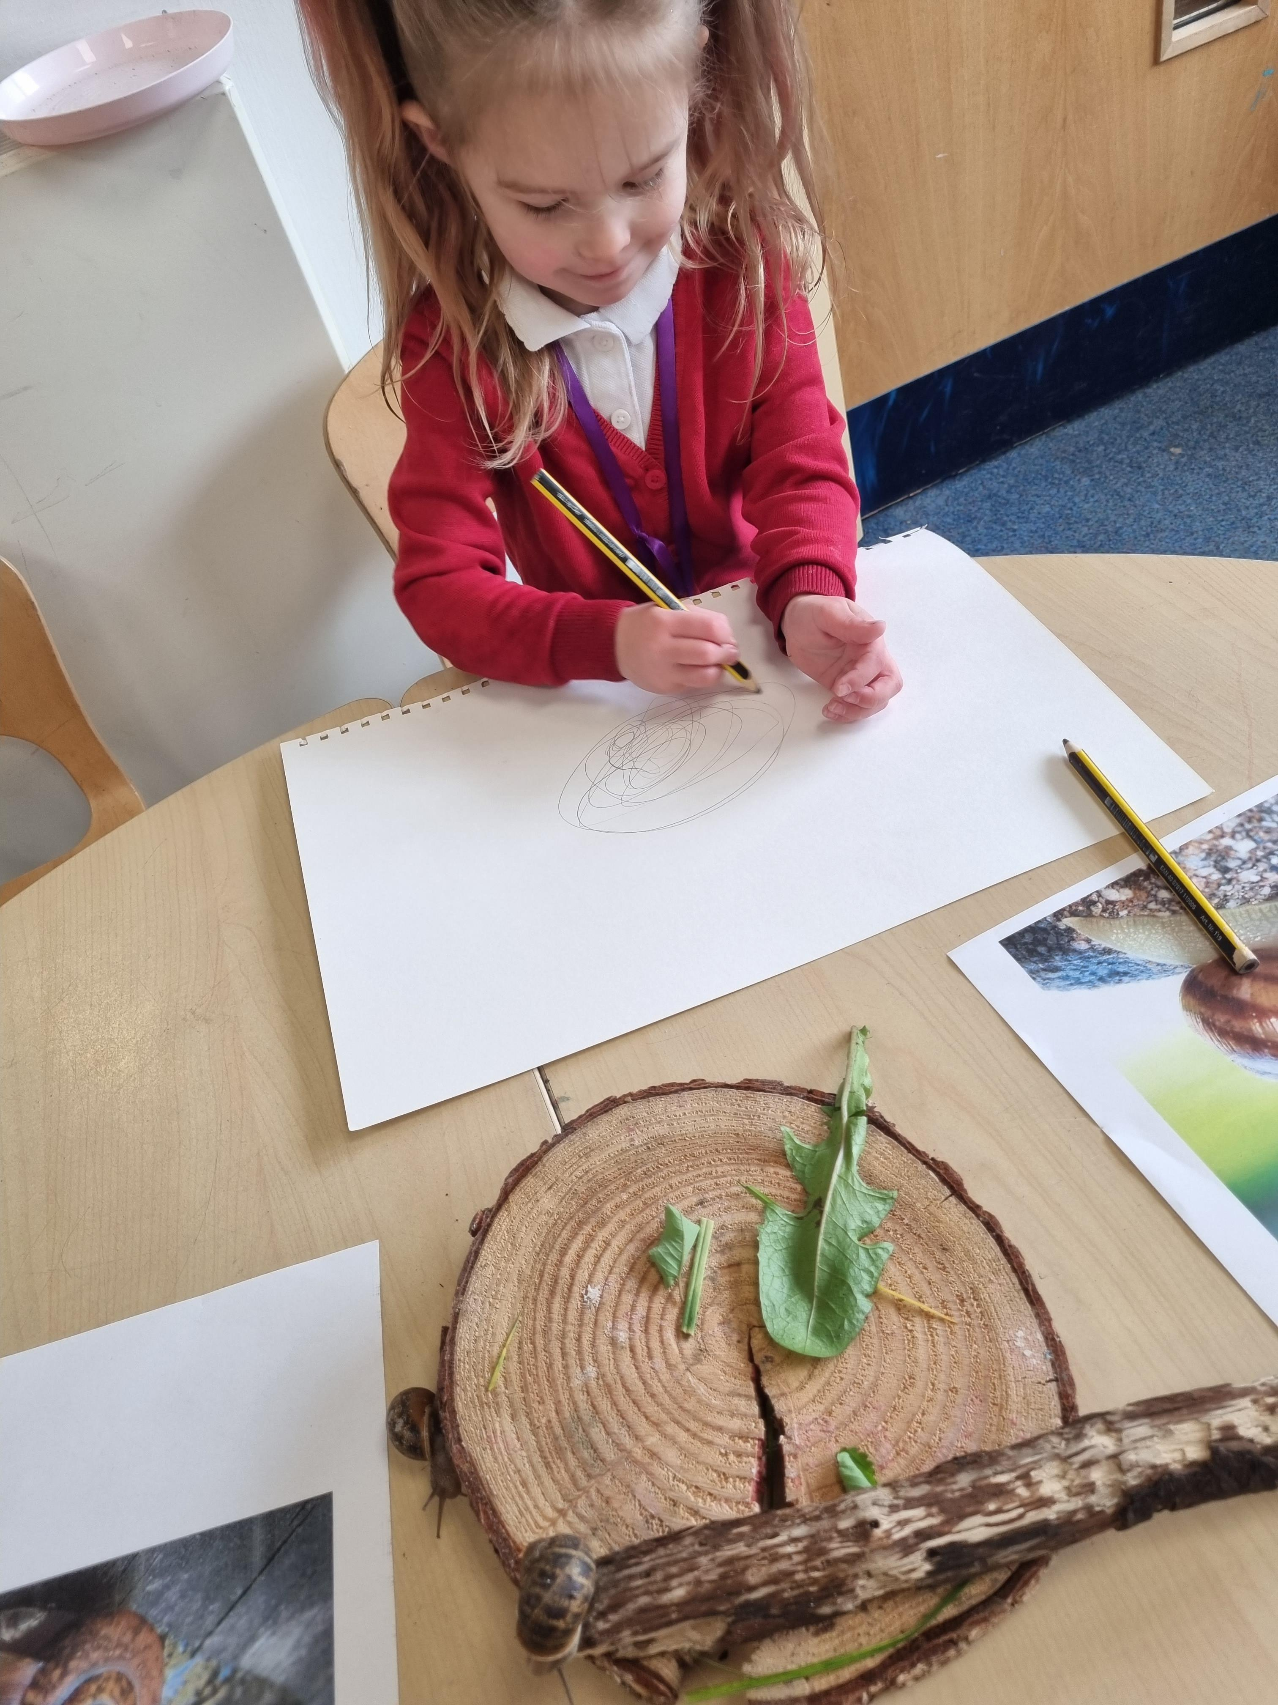

Extra Curricular activities
Each term the school hosts a menu of extra curricular activities for children at Sofrydd Primary. An updated menu of events is shared via the school communication channel Class Dojo.
The school has strong links with community groups who utilise the school facilities to provide activities for the young people of Sofrydd.

Slide 12
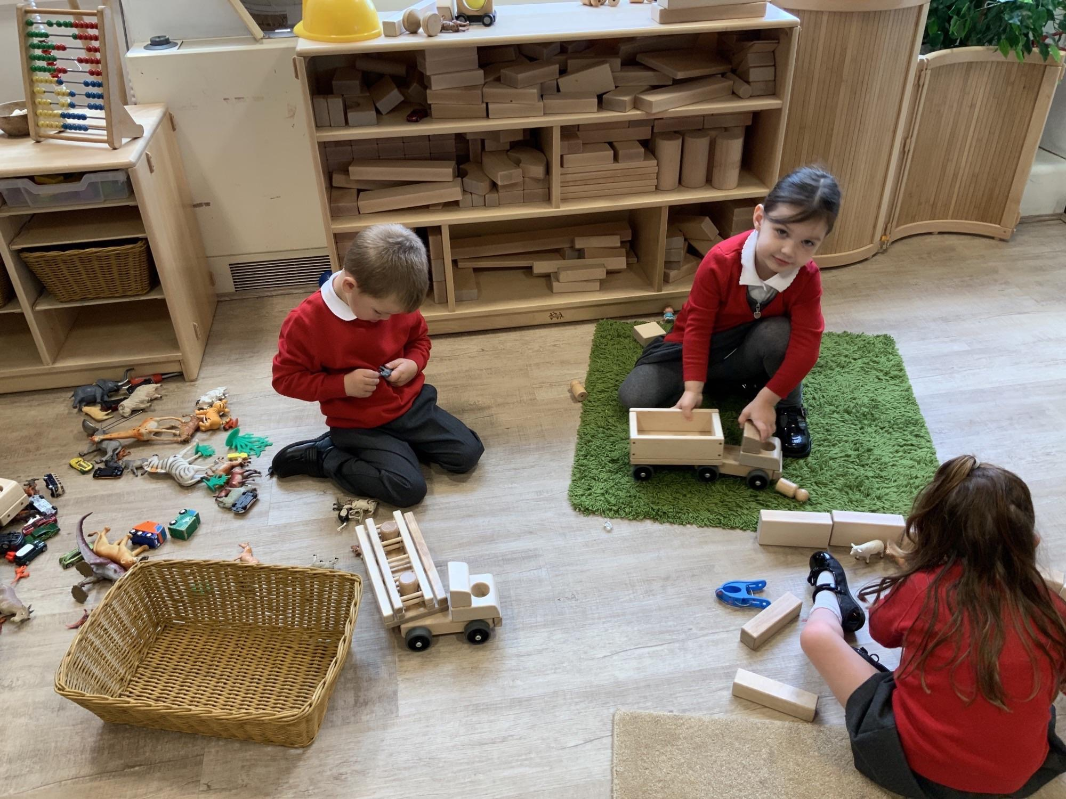
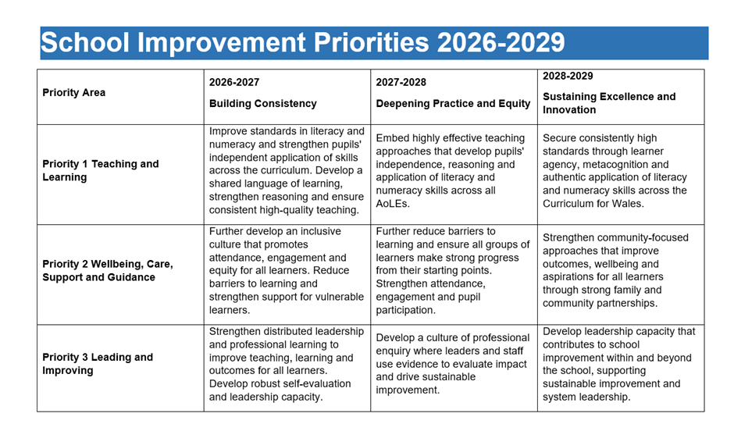
Summary of School Development Plan
The priority areas of school development planning for the academic year 2025-2028

